Slide 1
Research Progress of BLE & DIC & DAC
Jul 19, 2018
Xingyu Su

Slide 2
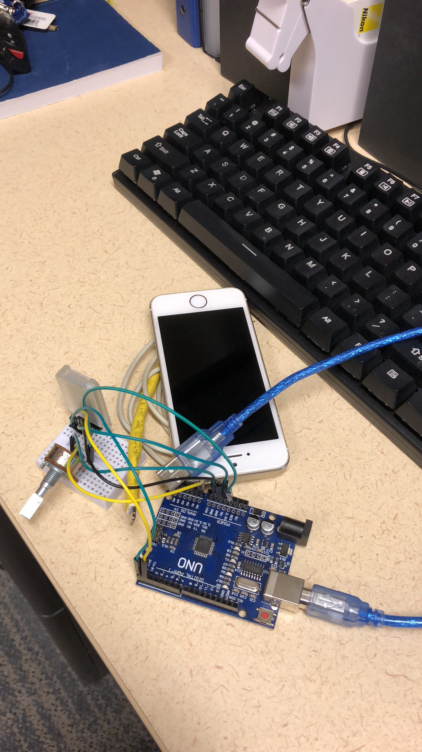
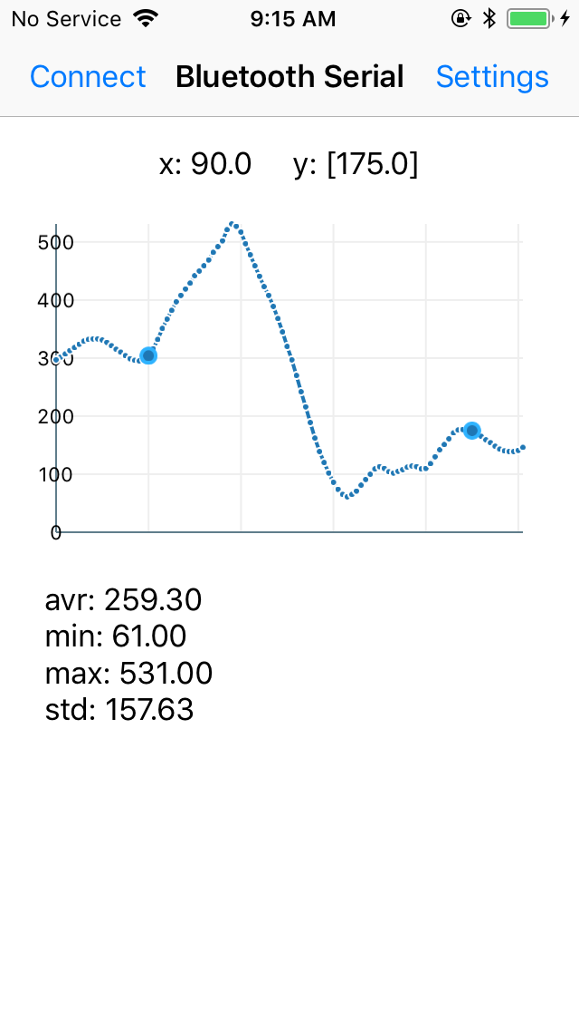
iOS BLE Application
Add some functions
Select 2 points
calculate statistical information and show
Revise the selected points’ X value error
Improve performance when selecting 2 points
BLE: Bluetooth Low Energy
Notes:
First is the application of iOS BLE communicating and illustrating.
I read all the code and modified some for my part.
It’s a bit simple and almost done.

Slide 3
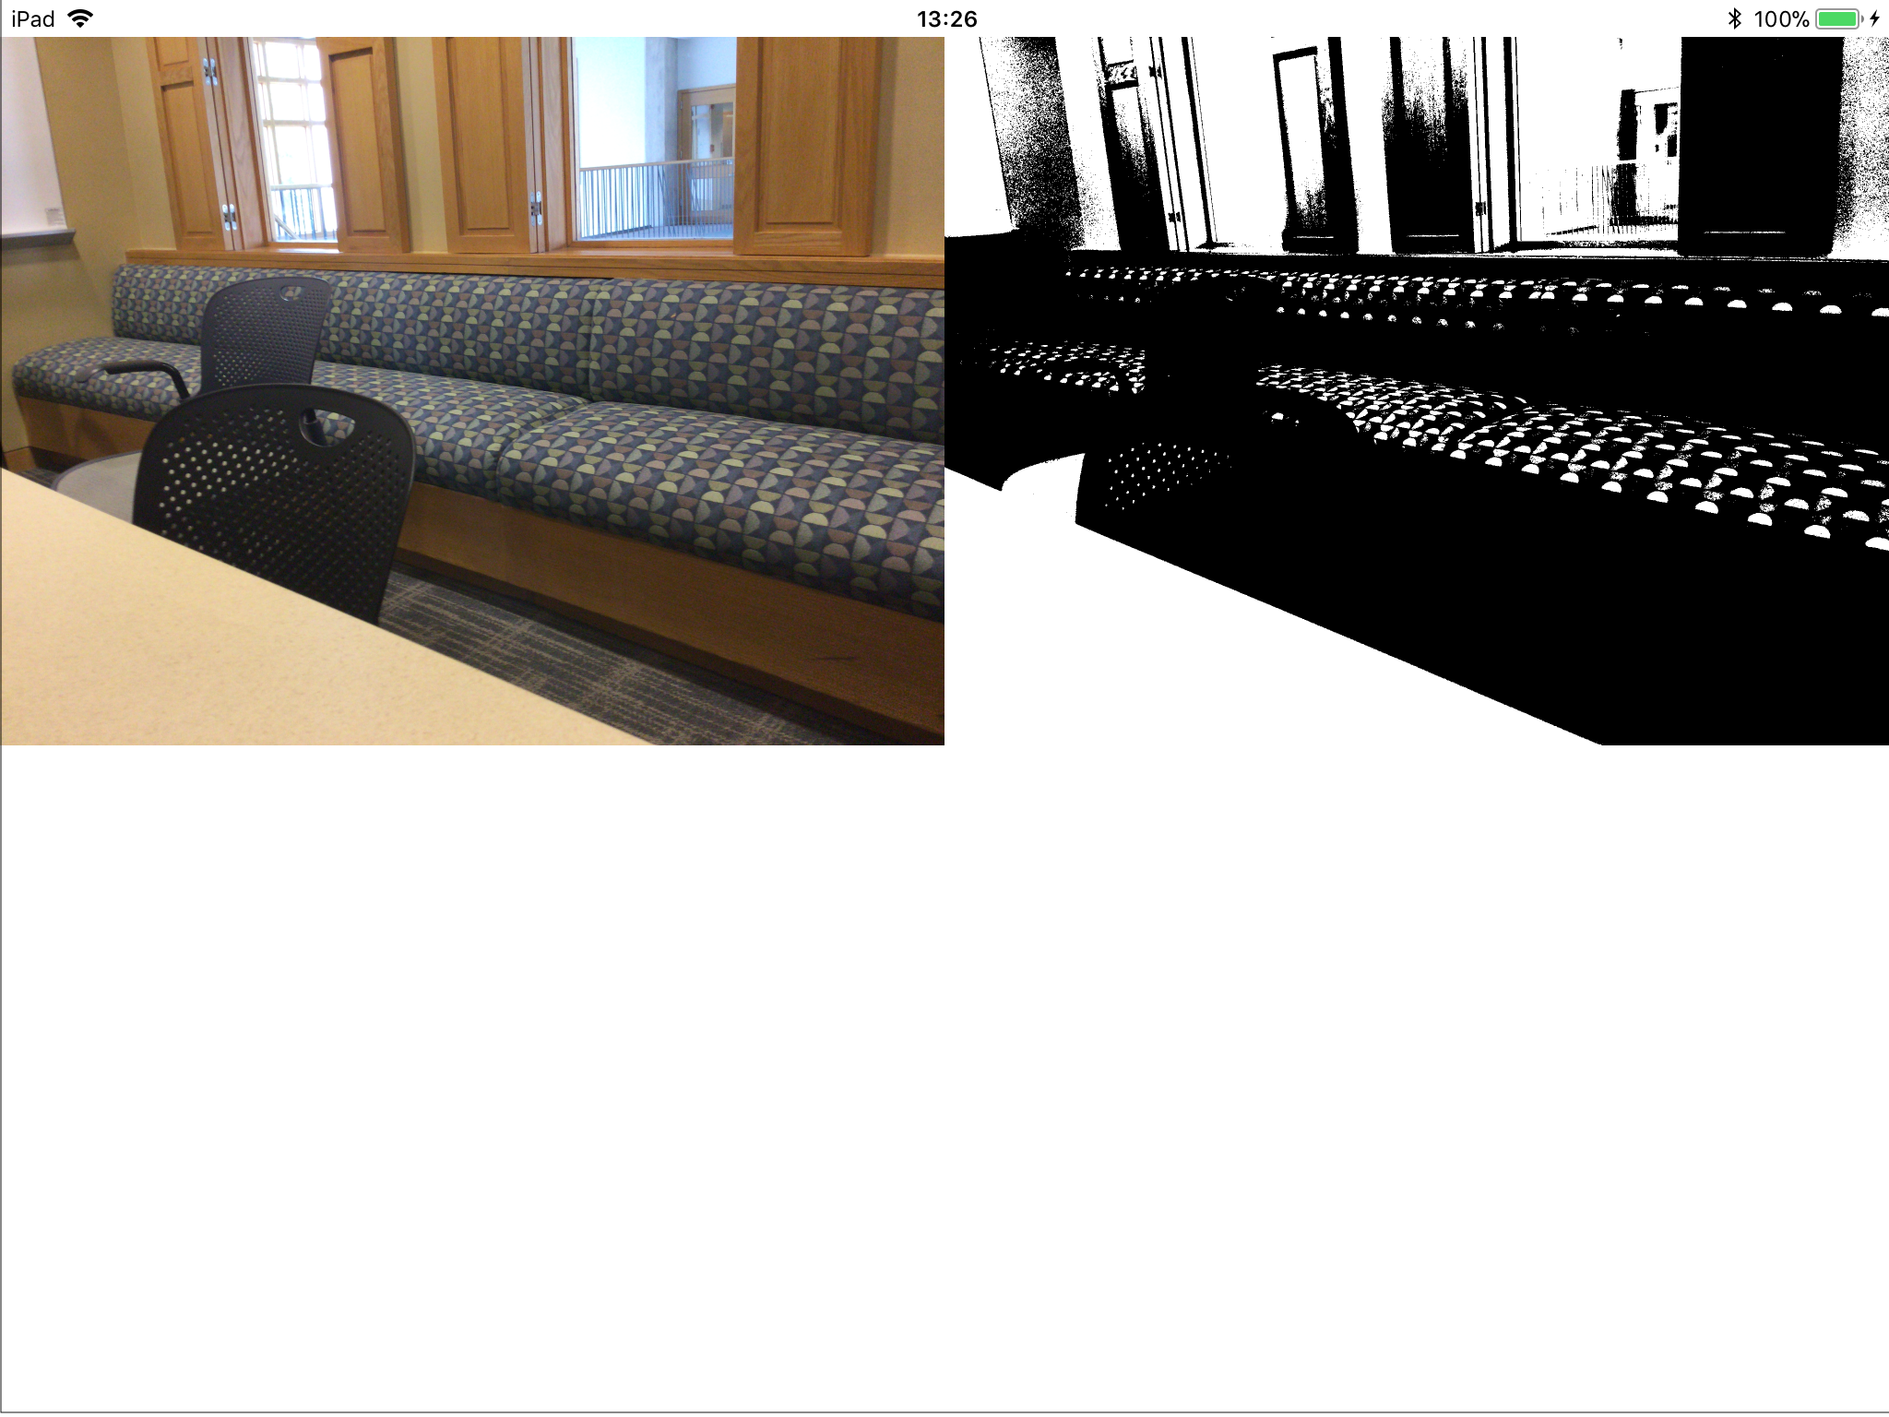
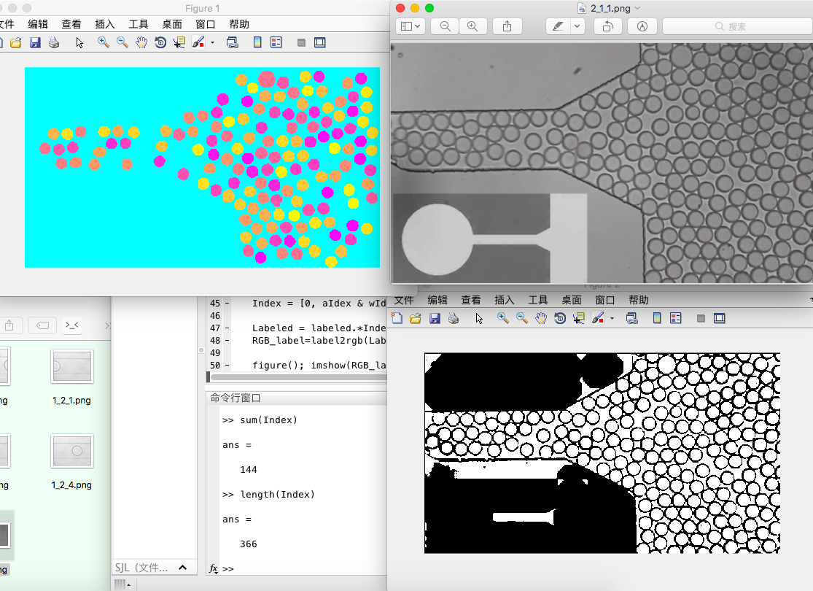
iOS Droplet Counter
Learning:
OpenCV learning
Makefile learning
Tests:
Camera Test
Matlab Test
OpenCV Test
Notes:
And Geonsoo arranged me another project. Droplet tracking by camera of iPhone.
After a period of learning and testing, the basic functions have been implemented.
One way I used is to detect the connected domain after image processing and check every region by it’s size and shape. You can see a demo of Matlab in the downside of this slide.

Slide 4
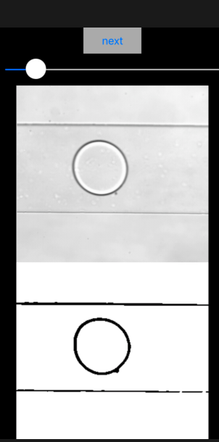
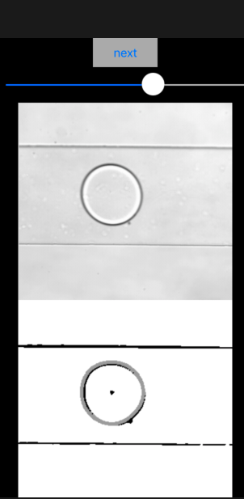
iOS Droplet Counter
Circle Hough Transform
Assume circle radius by provided range
Intersection point of every circle from every point corresponding to the center point of an original circle
Once center point fixed, adjusting radius to get the best result
Notes:
And the other way I used is a ready-made algorithm called Circle Hough Transformation.

Slide 5
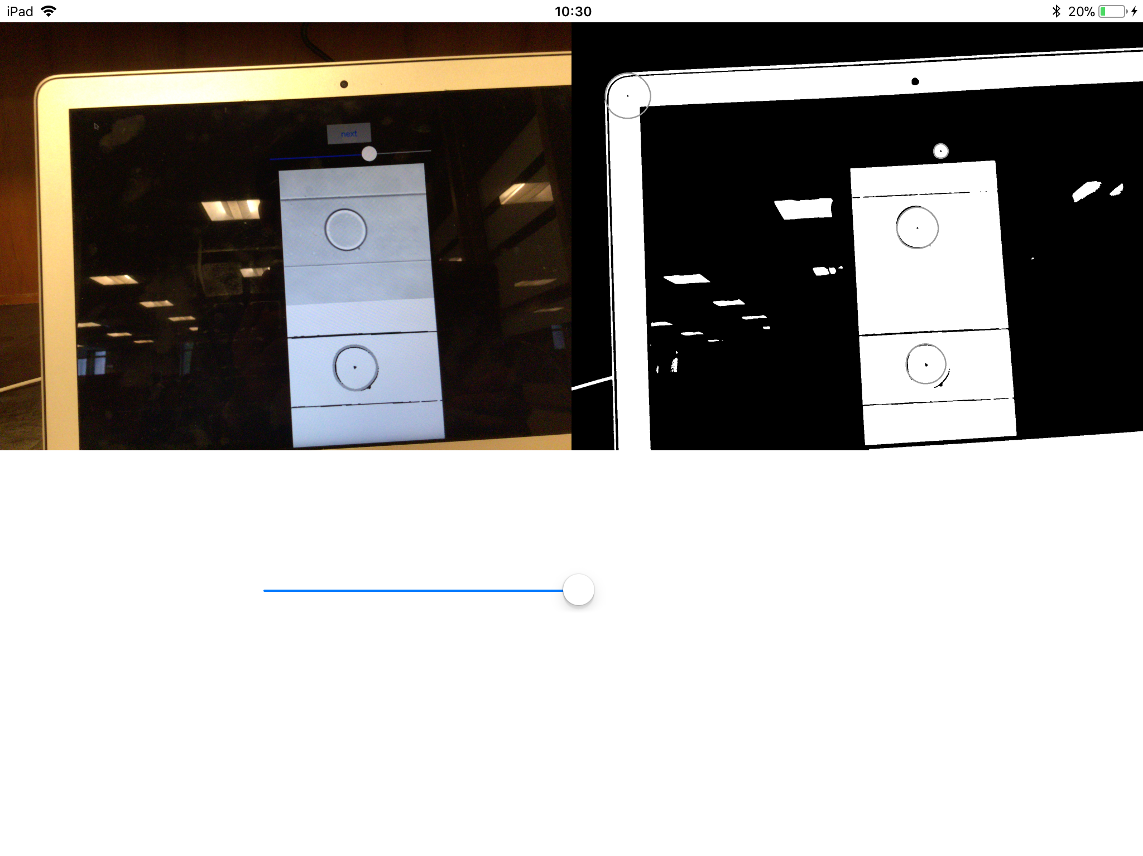
iOS Droplet Counter
Wrong
Correct
Notes:
But there will be some wrong results due to the unstable environment.

Slide 6
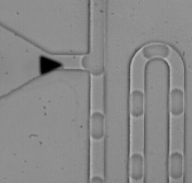
Droplet Area Calculator
Encoding & Decoding
The droplet generator can generate different length of droplets. (Steven)
By arranging their length’s order, we can get information encoded in the array of droplet.
So a decoder is needed now. My job is to recognize the length array by camera and image processing.

Slide 7
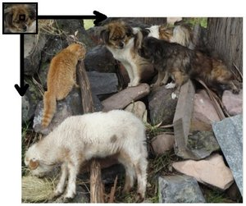
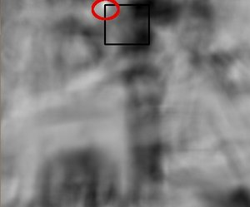
Droplet Area Calculator
Template Matching Algorithm
1. Slide the window ->
2. Match area similarity ->
3. Get similarity matrix

Slide 8
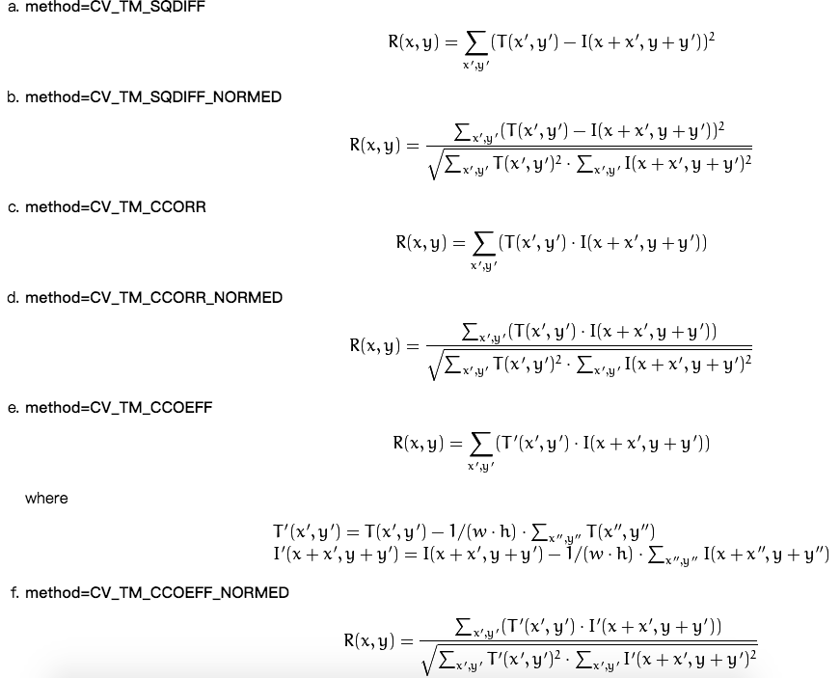
Droplet Area Calculator
Match methods

Slide 9
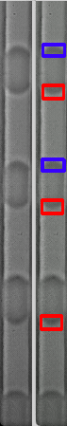
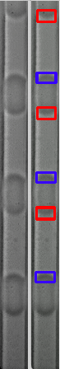
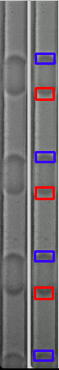
Droplet Area Calculator
Python demos
Improvements
Optimized by calculating a series of nearby points to be an average one.
Fastest
Slow down
Optimized

Slide 10
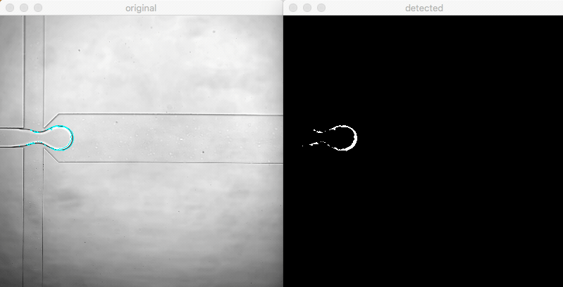
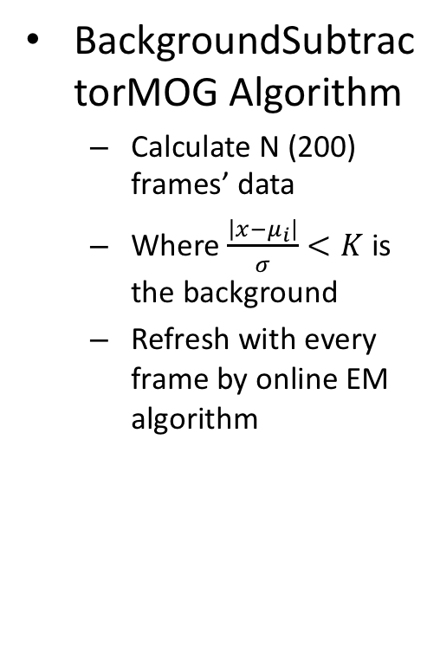
iOS Droplet Counter
BackgroundSubtractorMOG Algorithm
Calculate N (200) frames’ data
Where $\frac{\left|x−μ_{i}\right|}{σ}<K$ is the background
Refresh with every frame by online EM algorithm
MOG: Mixture of Gaussians
EM: Expectation-Maximization

Slide 11
Problems
[x] BLE Unable to destroy point layer
[x] DIC Memory Leak
[x] DIC Multi circles detecting by Hough transform
[x] DAC Template Matching Algorithm Optimizing
[x] DIC Test Background Subtractor Algorithm
[ ] DIC Algorithm Complexity
[ ] DIC Stable environment required
[ ] DAC Windows OpenCV & VC++
[ ] DAC Camera C++ SDK
Notes:
And the Hough Transform is time costly which means we can’t get ideal framerate and the tracking will be impossible.
So my next week plan is mainly about testing in real runner environment and improving algorithm.

Slide 12
Next week plan
DIC Test code with lens and runner
DIC Improve algorithm
DIC Complete document
DAC Test with Windows OpenCV & VC++
DAC Test Camera C++ SDK
Notes:
And yes, writing documents.

Slide 13
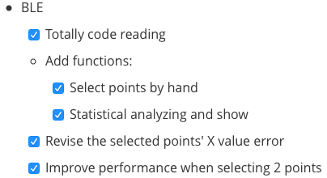
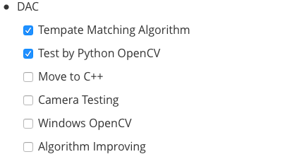
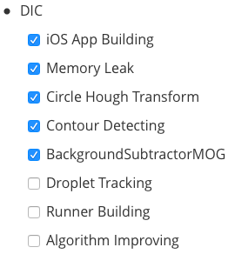
Overview

Slide 14
Appendix
HM10 Serial
OpenCV for iOS Book
Makefile
OpenCV Tutorial
Nikon DS QI2
FASTCAM mini AX 50
Wiki_Template Matching
OpenCV_Template Matching
BackgroundSubtractorMOG
Wiki Expectation Maximization
Notes:
Here are some reference.

Slide 15
Thanks
Notes:
Thanks all of you for watching and listening.

